Slide 1


VIRTUAL INTERNSHIP
8 WEEKS
MedTrack_DV
Hospital Operations &
Patient Analytics Dashboard
Turning patient-level records into a clear, interactive view of hospital activity and performance.
Presented by :
Amrutha
Project Mentor :
Likitha
PATIENTS
AVG LOS
AVG BILL
984
7.9
21,415

Slide 2
PROJECT ROADMAP
02
Table of Contents
01
Project foundation
02
Data & preparation
Abstract, introduction, problem & objectives
Dataset, tools, cleaning & methodology
03
Analytics journey
04
Dashboard showcase
EDA, KPIs and calculated age groups
Four connected hospital analytics views
05
What we learned
06
Closing
Findings, benefits, limitations & scope
Conclusion and discussion
MedTrack_DV
2

Slide 3
PROJECT SUMMARY
03
Abstract
MedTrack_DV turns 984 patient records into an interactive visual story for understanding hospital activity and performance.
01
UNDERSTAND
Review patient, admission, demographic, financial and operational fields.
02
PREPARE
Clean, standardize and transform the data for analysis.
03
VISUALIZE
Build connected dashboard views for hospital, patient, department and resource analysis.
The result is a single visual layer where users can explore KPIs, patient trends, department comparisons, billing, length of stay and geography.
MedTrack_DV
3

Slide 4
CONTEXT
04
Introduction
RAW
DATA
→
DATA
PREP
→
ANALYZE
→
DASHBOARD
→
INSIGHTS
Patient records
Clean & standardize
Patterns & KPIs
Interactive views
Faster understanding
Why data-driven healthcare matters
Why MedTrack_DV
Hospitals generate many patient and operational fields. A visual dashboard helps bring those fields together so trends are easier to compare and review.
The project converts raw records into a structured analytical view covering admissions, status, demographics, length of stay, billing and location.
MedTrack_DV
4

Slide 5
THE CHALLENGE
05
Problem Statement
How can hospital and patient data be transformed into an interactive analytical dashboard that enables faster understanding of healthcare operations and patient trends?
Large datasets
Manual analysis
Important information is spread across many patient and operational fields.
Comparing trends and categories by hand is slow and repetitive.
Hidden patterns
Need for clarity
Raw tables do not make changes, gaps and distributions easy to spot.
Decision-makers need concise KPIs and visuals in one place.
MedTrack_DV
5

Slide 6
FIVE PRIORITIES
06
Objectives
01
Prepare the data
Clean and organize the patient dataset for reliable analysis.
02
Explore patterns
Examine patient, admission, demographic and operational trends.
03
Create KPIs
Turn key measures into easy-to-read summary cards.
04
Build dashboards
Combine charts, maps and filters into interactive views.
05
Communicate insights
Make healthcare data easier to understand and discuss.
MedTrack_DV
6

Slide 7
984 PATIENT RECORDS
07
Dataset Overview
Hospital_Data / Hospital_Dataset_984_Patients
984
patient records
Patient
Admission
Clinical / Status
IDs, age, gender and patient-level attributes
Admission date, discharge context and type
Condition-related fields and patient status
Financial
Insurance / Room
Operations / Location
Billing and payment-related information
Coverage and room usage dimensions
Length of stay, satisfaction, city and state
Age groups used in the dashboard: 0–18 • 19–30 • 31–40 • 41–50 • 51–60 • 61+
MedTrack_DV
7

Slide 8
PROJECT STACK
08
Technologies & Tools
Python
Pandas
Excel
Data preparation and transformation
Tabular data handling
Data storage / preparation
Tableau
Data Visualization
Dashboard Design
Dashboard creation and visual analytics
Charts, maps and interactive views
Layout, filtering and storytelling
MedTrack_DV
8

Slide 9
END-TO-END WORKFLOW
09
Methodology
Data Collection
Data Understanding
1
2
Start with the supplied hospital patient dataset.
Review field meaning and identify analysis dimensions.
Data Cleaning
Data Transformation
3
4
Check consistency, data types and record quality.
Create usable categories and analytical fields.
Exploratory Analysis
KPI Creation
5
6
Study distributions, trends and relationships.
Define the main hospital-level measures.
Dashboard Development
Insights
7
8
Assemble charts, maps, filters and KPI cards.
Use the visuals to communicate clear findings.
MedTrack_DV
9

Slide 10
MAKING THE DATA DASHBOARD-READY
10
Data Preprocessing & Calculated Fields
1
Structure check
2
Missing values
3
Duplicates
4
Standardization
5
Metric readiness
Review columns and field types
Identify and handle where required
Check for repeated patient records
Keep categorical values consistent
Prepare numerical and date fields
AGE GROUP FORMULA
IF Age ≤ 18 → 0–18
ELSE IF Age ≤ 30 → 19–30
ELSE IF Age ≤ 40 → 31–40
ELSE IF Age ≤ 50 → 41–50
ELSE IF Age ≤ 60 → 51–60
ELSE → 61+
Total Patients
Avg Age
Avg LOS
Avg Bill
Avg Satisfaction
COUNTD(Patient ID)
AVG(Age)
AVG(Length of Stay Days)
AVG(Total Bill Amount)
AVG(Satisfaction Rating)
MedTrack_DV
10

Slide 11
QUESTIONS ANSWERED BEFORE DASHBOARD DESIGN
11
Exploratory Data Analysis
Who are the patients?
Why are they admitted?
Age, gender and location patterns
Admission type and hospital activity
What is the current status?
How long do they stay?
Deceased, discharged, recovered, referred and under treatment
Length of stay by patients and departments
What does activity cost?
Where are patients located?
Billing and financial patterns
City and state distribution
EDA gave the structure for the four dashboard views that followed.
MedTrack_DV
11

Slide 12
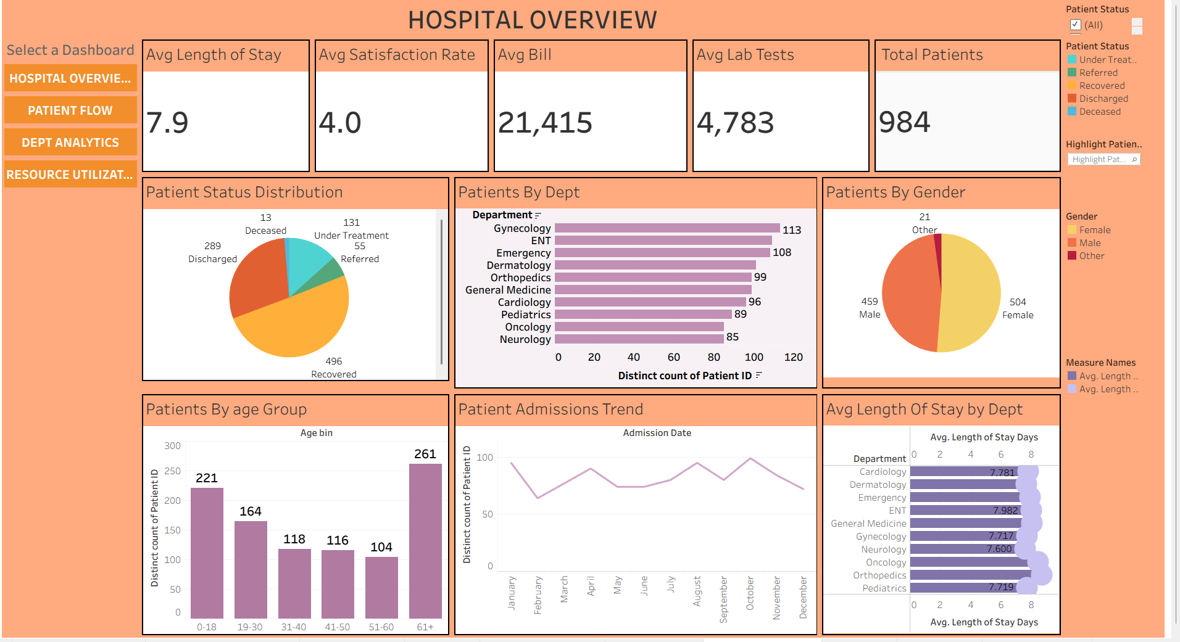
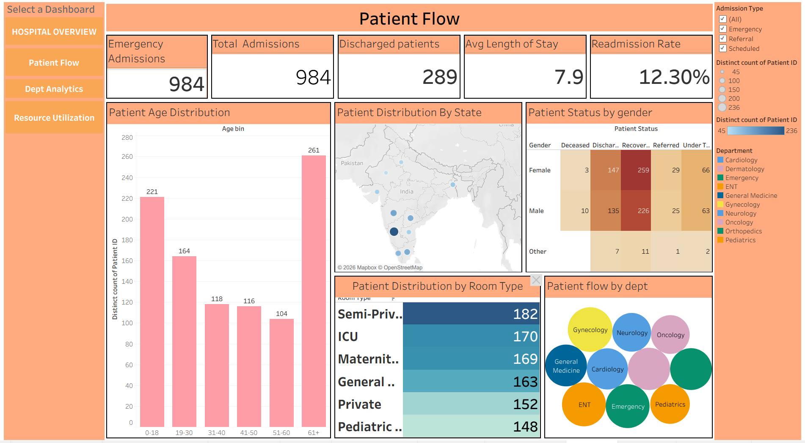
DASHBOARD SHOWCASE — PART 1
12
Hospital Overview + Patient Flow
HOSPITAL OVERVIEW
PATIENT FLOW
Overall KPIs, patient status, departments, gender, age and monthly admissions.
Admissions, patient age, status by gender, room type and department flow.
MedTrack_DV
12

Slide 13
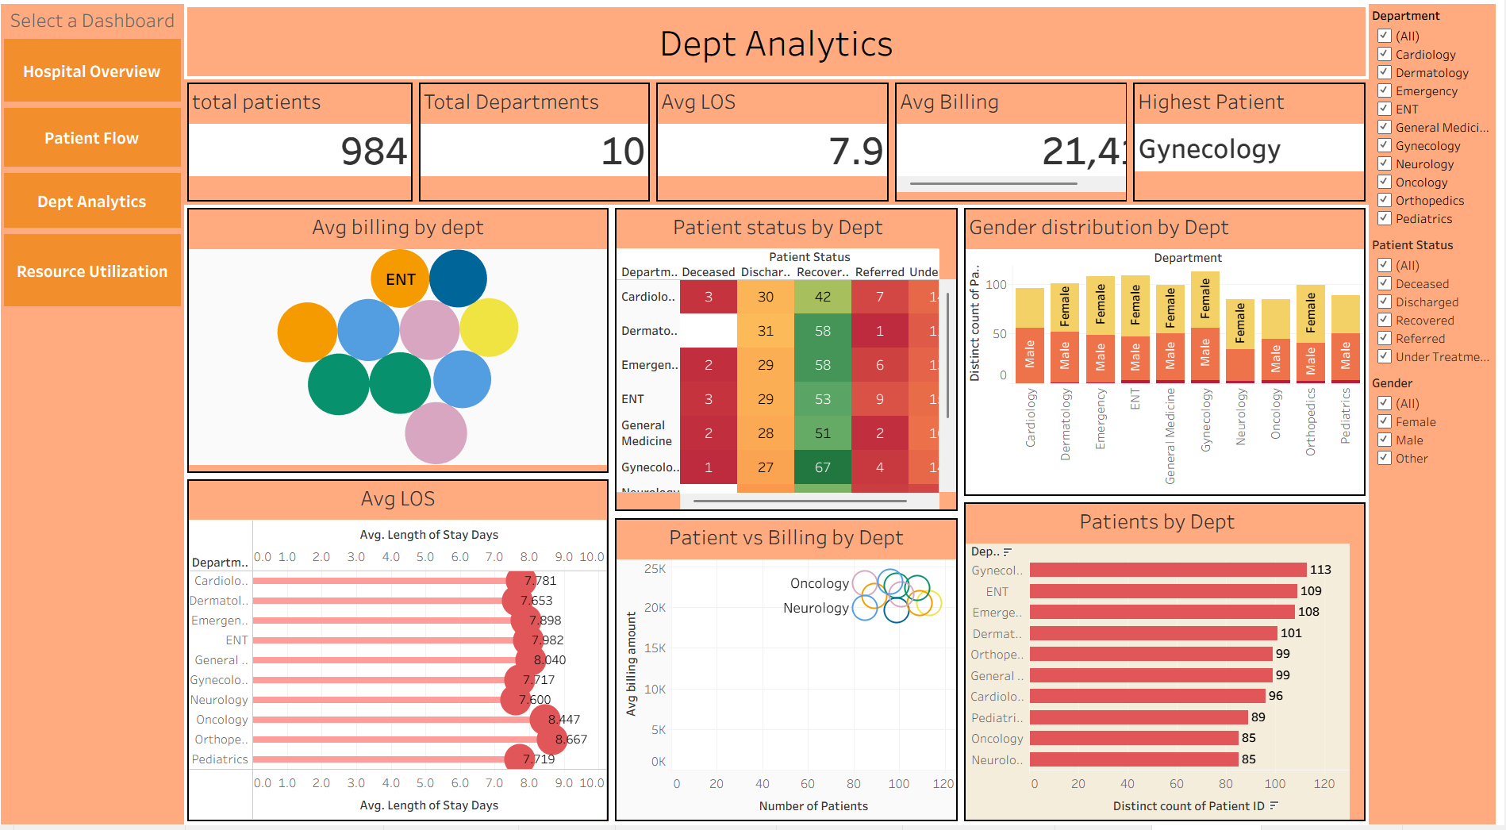
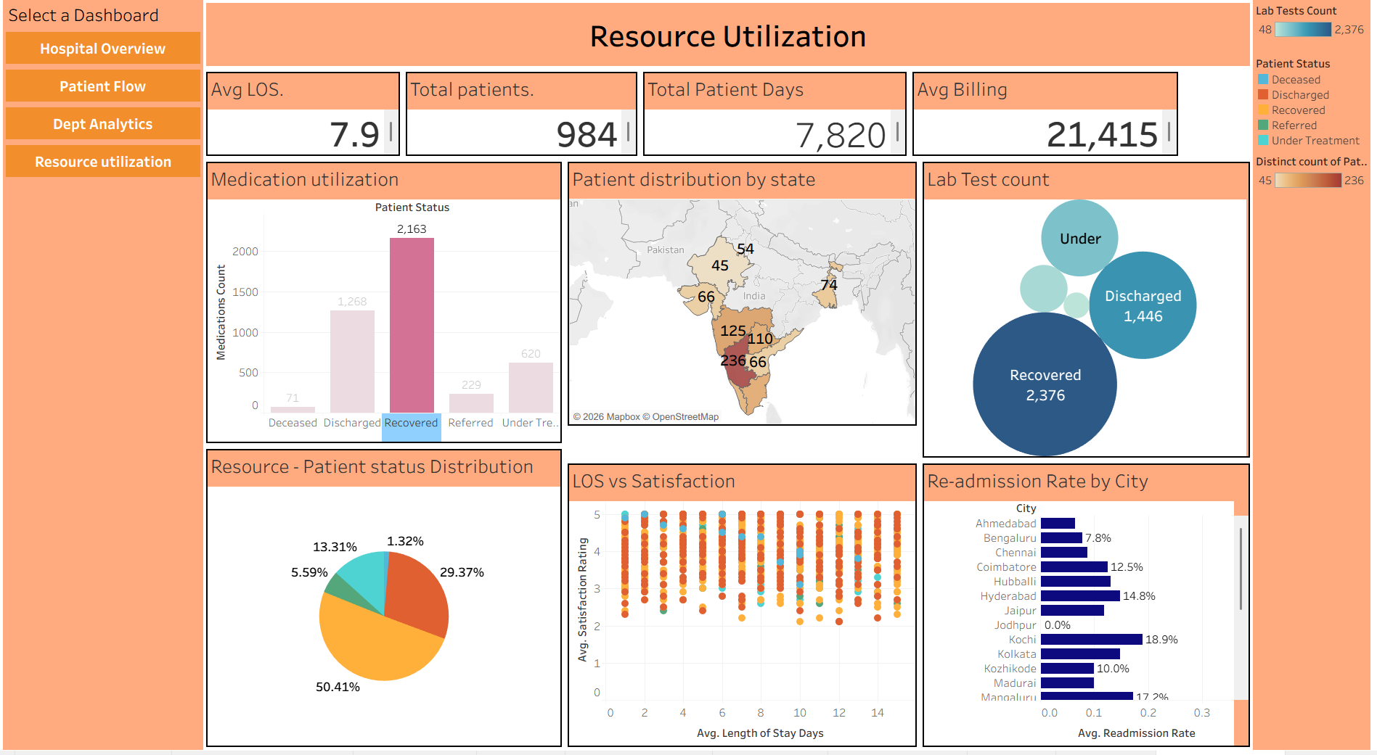
DASHBOARD SHOWCASE — PART 2
13
Department Analytics + Resource Utilization
DEPARTMENT ANALYTICS
RESOURCE UTILIZATION
Department-wise patient counts, gender, status, LOS and billing comparisons.
Location, billing, length of stay, patient status and operational indicators.
MedTrack_DV
13

Slide 14
WHAT THE HEADLINE NUMBERS MEAN
14
KPI Snapshot
Total Patients
Average LOS
Average Bill
Average Satisfaction
Average Lab Tests
984
7.9
21,415
4.0
4,783
Distinct patients
Days stayed
Average bill
Average rating
Total lab tests
Why KPIs matter
1
Give a quick hospital-wide summary before detailed charts.
2
Allow viewers to compare key measures across views.
3
Keep the most important numbers visible during analysis.
MedTrack_DV
14

Slide 15
WHAT THE DASHBOARDS MAKE EASY TO SEE
15
Key Findings
Patient mix
Age pattern
Recovered is the largest patient-status group in the Hospital Overview.
The 61+ group is the largest age group in the Hospital Overview.
Department pattern
Gender view
Gynecology has the highest patient count in the Department Analytics view.
The Hospital Overview shows Female 504 and Male 459.
Geography
Operational context
The dashboards provide city/state patient distribution through map visuals.
Department and resource views connect patient activity with LOS, billing and status.
MedTrack_DV
15

Slide 16
WHO BENEFITS FROM THE DASHBOARD
16
Benefits & Applications
1
Faster review
A single visual layer reduces time spent scanning raw tables.
2
Interactive exploration
Filters and views let users examine specific dimensions.
3
Operational visibility
Admissions, status, LOS and departments are easier to compare.
4
Financial context
Billing-related views add a business perspective to patient activity.
5
Management support
The dashboard provides a practical summary for hospital administrators.
MedTrack_DV
16

Slide 17
KEEP THE SCOPE REALISTIC
17
Limitations
!
The analysis is limited to the fields available in the supplied hospital dataset.
!
The workbook is an analytical dashboard, not a live hospital information system.
!
Bed occupancy or department efficiency should not be claimed without the required capacity/resource fields.
!
Predictive analytics and real-time integration are outside the current dashboard scope.
MedTrack_DV
17

Slide 18
WHERE MEDTRACK_DV CAN GO NEXT
18
Future Scope
01
02
03
Real-time integration
Predictive analytics
Advanced AI / ML
Connect live hospital systems.
Predict readmission & stay.
Add intelligent health analytics.
04
05
06
Alerts
Mobile reporting
Automated reports
Create real-time alerts.
Use mobile-friendly dashboards.
Generate recurring summaries.
MedTrack_DV
18

Slide 19
WHAT THE PROJECT DEMONSTRATES
19
Conclusion
•
Hospital patient records can be converted into a connected analytical story instead of remaining raw tables.
•
Data preparation and calculated age groups make the information easier to compare.
•
The four dashboard views provide different perspectives: overall hospital, patient flow, departments and resource-related measures.
•
The project demonstrates how data visualization can make healthcare data easier to understand.
•
MedTrack_DV provides a foundation for future AI/ML-driven healthcare analytics.
MedTrack_DV transforms hospital data into meaningful visual insights for smarter and more informed healthcare analysis.
MedTrack_DV
19

Slide 20
THANK YOU

